Slide 1

Predicting Estimated Delivery Time

Slide 2
Contents
1. Introduction
4. Method 2: Decision Tree
5. Method 3: SVR + MLP Stacked Ensemble Regression
2. Data Pre-processing steps
3. Method 1: K-Nearest Neighbors
6. Method 4: Random Forest
8. Insights & Recommendations
7. Method 5: XGBoost

Slide 3
Problem Statement
To predict the estimated delivery time (ETA) for food orders using machine learning
Why this matters?
Late deliveries lead to customer dissatisfaction
Accurate ETA improves customer trust and operational efficiency
Helps businesses manage resources, traffic, and delivery loads better
Our Approach:
Performed EDA and visualizations to explore delivery trends
Built a predictive model using KNN, Decision Trees, XGBoost, Random Forest, SVR + MLP stacked ensemble regression model
Identified the most important factors that affect delivery time

Slide 4
Dataset Summary
Food Delivery Dataset (Kaggle)
Target Variable:
Time_taken(min) – actual delivery time in minutes
Key Features:
Delivery Person Info: Delivery_person_Age, Delivery_person_Ratings, multiple_deliveries, Vehicle_condition, Type_of_vehicle
Order & Timing Details: Order_Date, Time_Ordered, Time_Order_picked, Order_to_Pickup_Duration,Type_of_order
Geolocation: Restaurant_latitude/longitude, Delivery_location_latitude/longitude
External Factors: Weatherconditions, Road_traffic_density, Festival, City

Slide 5
Data Pre-processing Steps
Data Cleaning & Type Conversion
Feature Engineering
Missing Value Handling
Encoding & Transformation
Scaling & Splitting
Notes:
1. Data Cleaning & Type Conversion
• Removed text artifacts (e.g., “(min)”, “conditions”)
• Converted numeric and datetime columns to appropriate types
2. Missing Value Handling
• Dropped rows with exactly 3 blanks in key fields
• Imputed Delivery_person_Ratings, Festival, and City with mode
• Dropped remaining rows with missing values (~4%)
3. Feature Engineering
• Calculated Delivery_distance_km using geodesic distance
• Computed Order_to_Pickup_Duration in minutes
4. Encoding & Transformation
• Ordinal encoding: Road_traffic_density
• One-hot encoding: categorical features
• Converted boolean features to binary (0/1)
5. Scaling & Splitting
• Standardized numerical features with StandardScaler
• Performed 80/20 stratified train-test split (random_state=42)

Slide 6
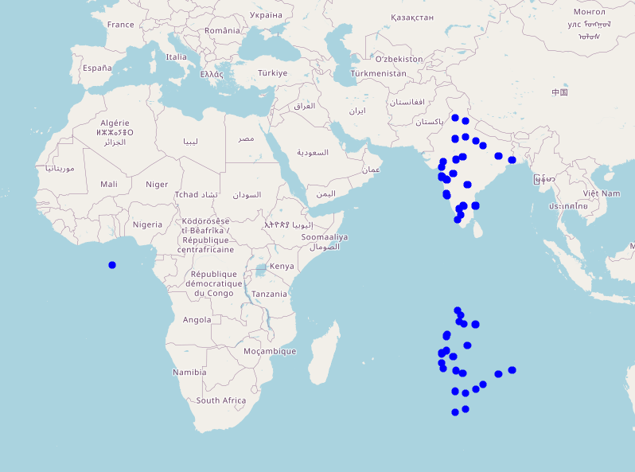
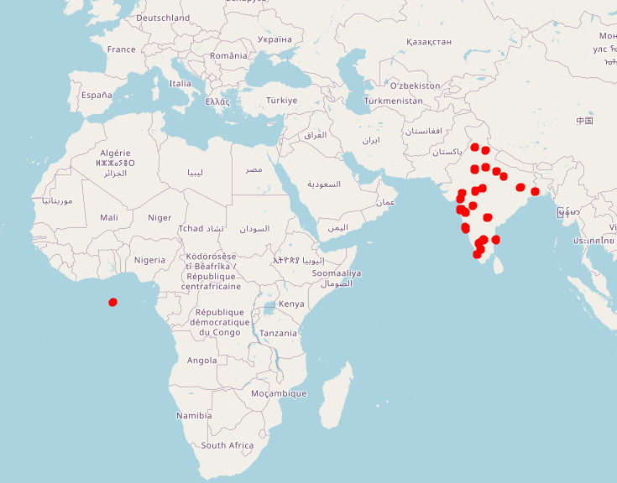
Exploratory Data Analysis
Restaurant Locations
Delivery Locations

Slide 7
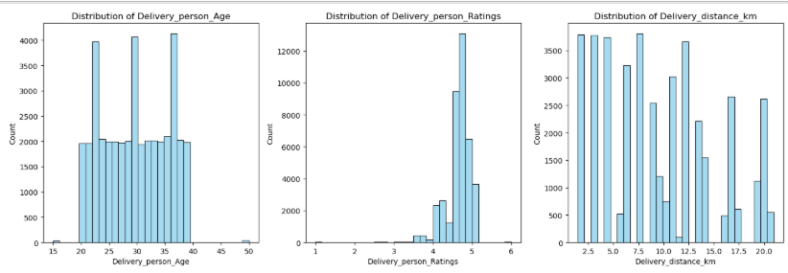
Exploratory Data Analysis - Numerical Variables

Slide 8
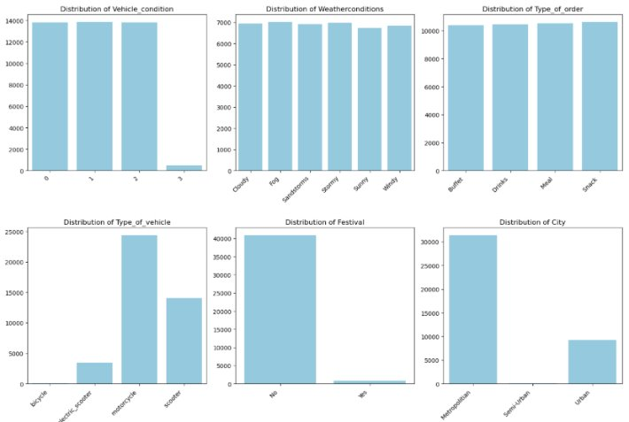
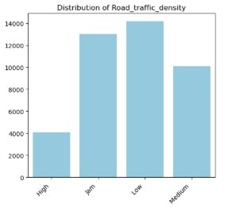
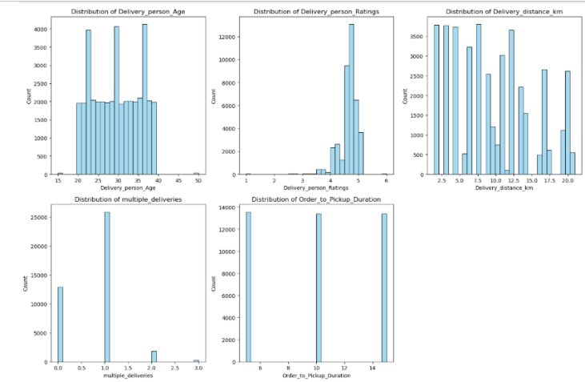
Exploratory Data Analysis- Categorical Variables

Slide 9
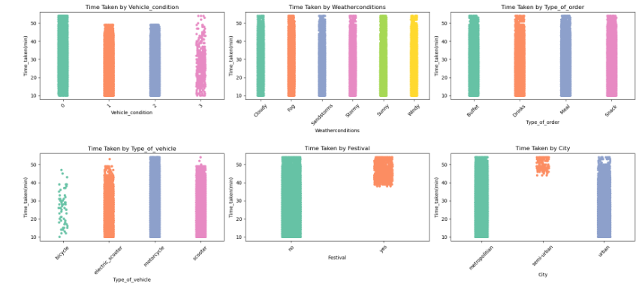
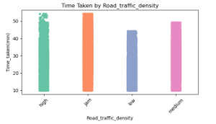
Exploratory Data Analysis - Scatter Plots

Slide 10
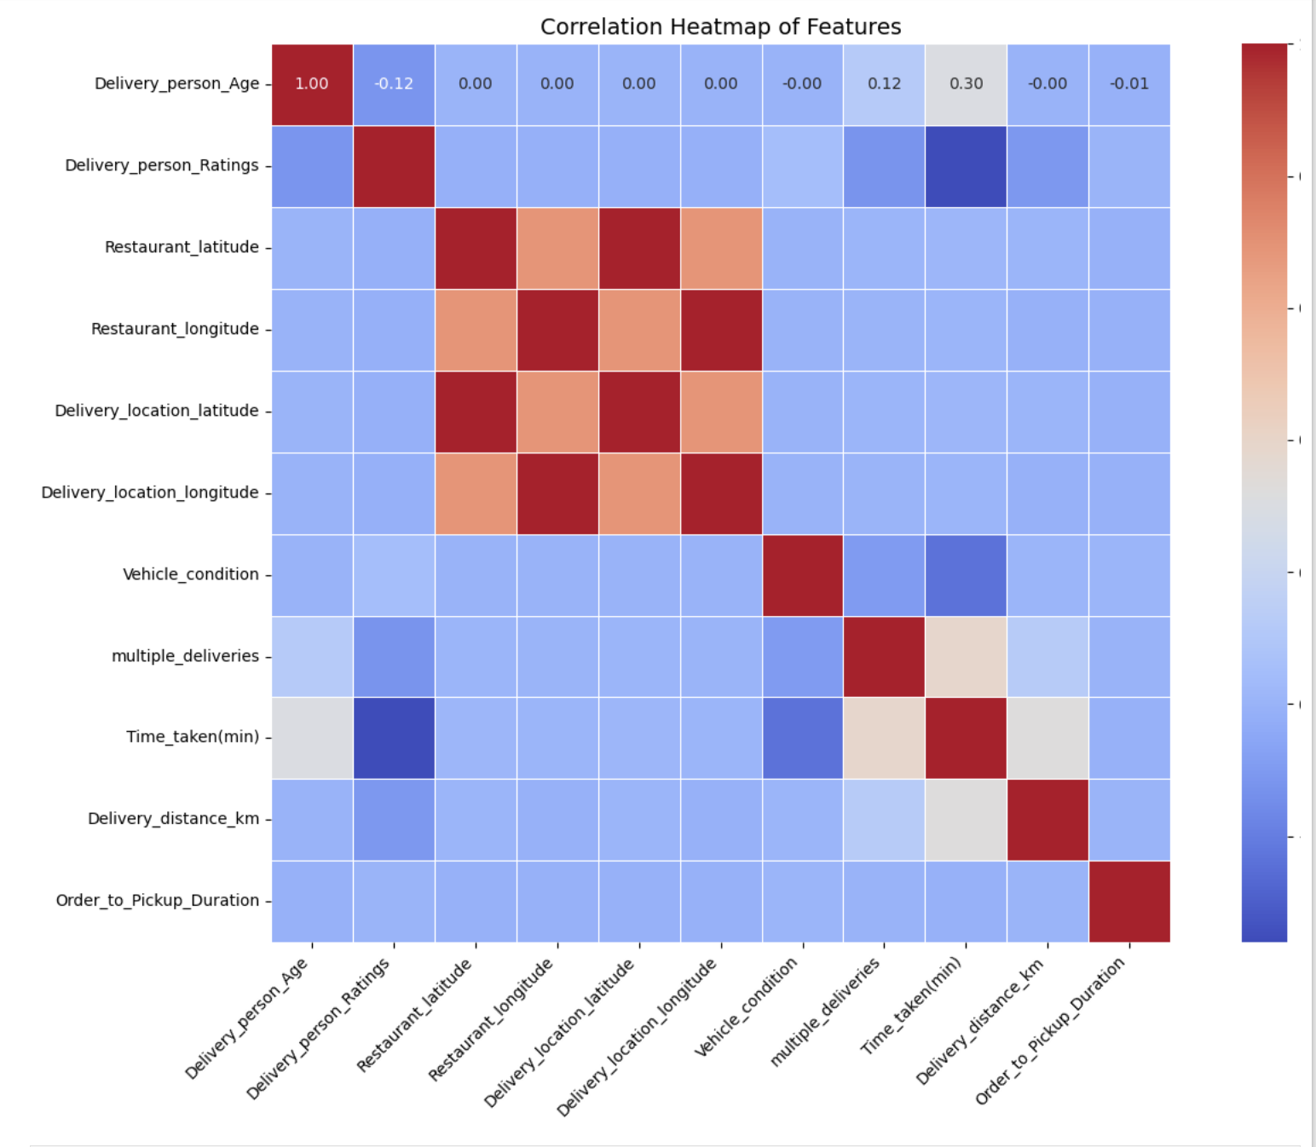
Correlation Heatmap
Features like delivery distance, driver age and multiple deliveries show positive correlation with delivery time
Delivery person ratings and vehicle condition show negative correlation with delivery time

Slide 11
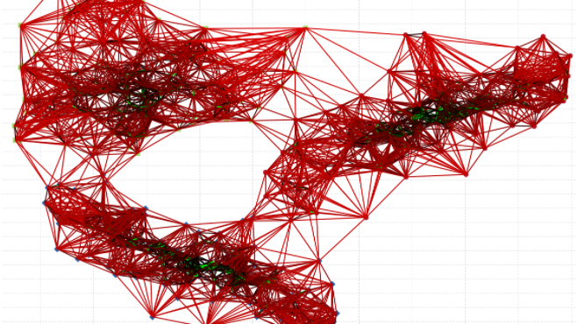
K-Nearest Neighbors

Slide 12

k-Nearest Neighbors Regressor (KNeighborsRegressor)
Metric | Value
MAE | 5.05 minutes
RMSE | 3.96 minutes
R² | 0.7097
Adjusted R² | 0.7090
Component | Details
Grid Search Strategy | 5-Fold Cross-Validation
Tuned Parameter | k (Number of Neighbors)
Search Space | {5, 10, 15, 20, 25}
Best k | 15
Mean CV R² Score | 0.7029

Slide 13
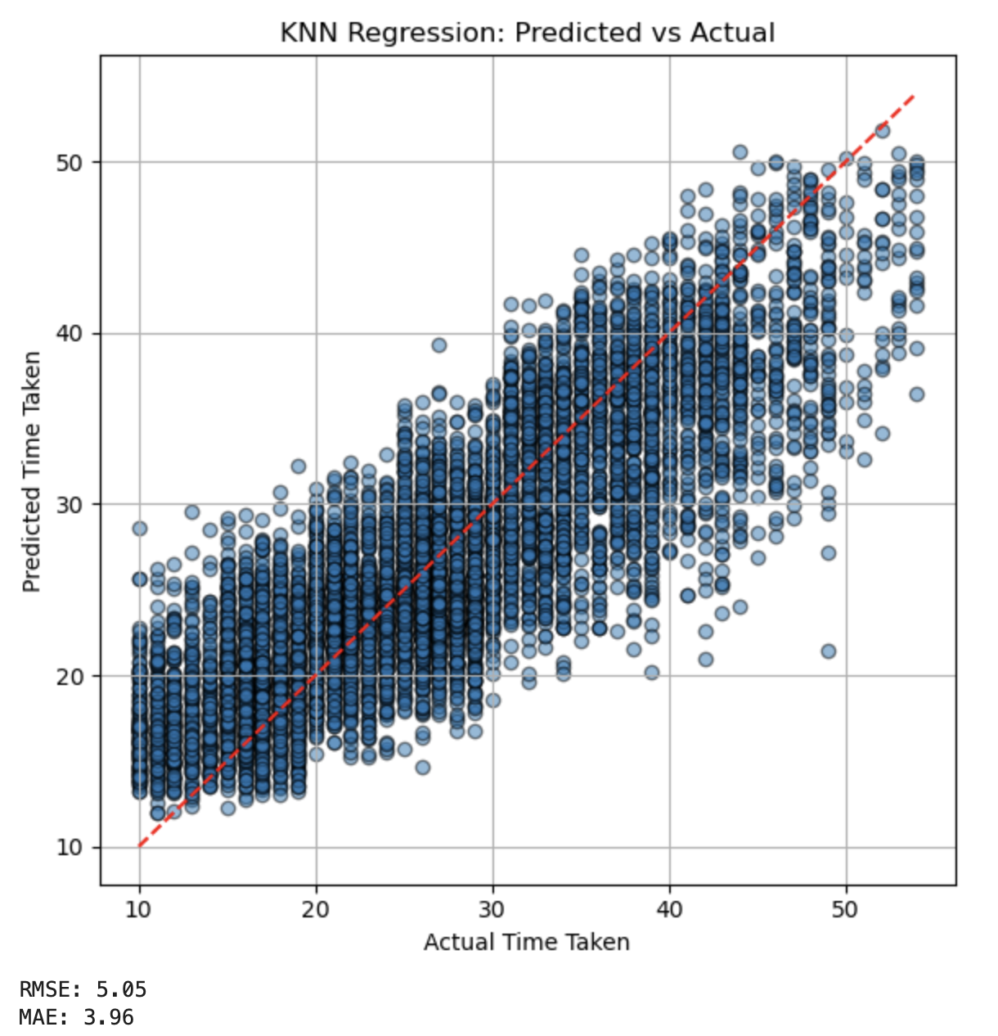
KNN Regression: Predicted vs Actual
Notes:
The red line fails to present the actual situation very well.

Slide 14

Decision Tree

Slide 15

DecisionTree Regressor with random_state = 0
Metric | Value
MAE | 3.22 minutes
RMSE | 4.06 minutes
R² | 0.8125
Adjusted R² | 0.8120
Component | Details
Grid Search Strategy | 5-Fold Cross-Validation
Tuned Parameter | Max_depth
Search Range | [2,19]
Best Max_depth | 12
Mean CV R² Score | 0.8048

Slide 16
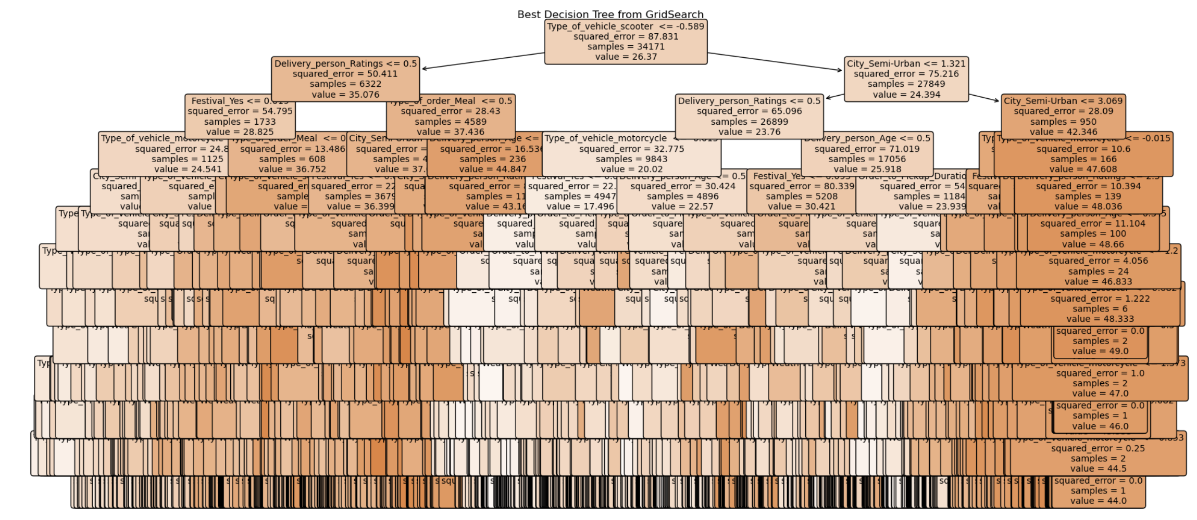
Result
Notes:
At first glance, you’d expect it to do one thing — but in reality, it does the opposite

Slide 17
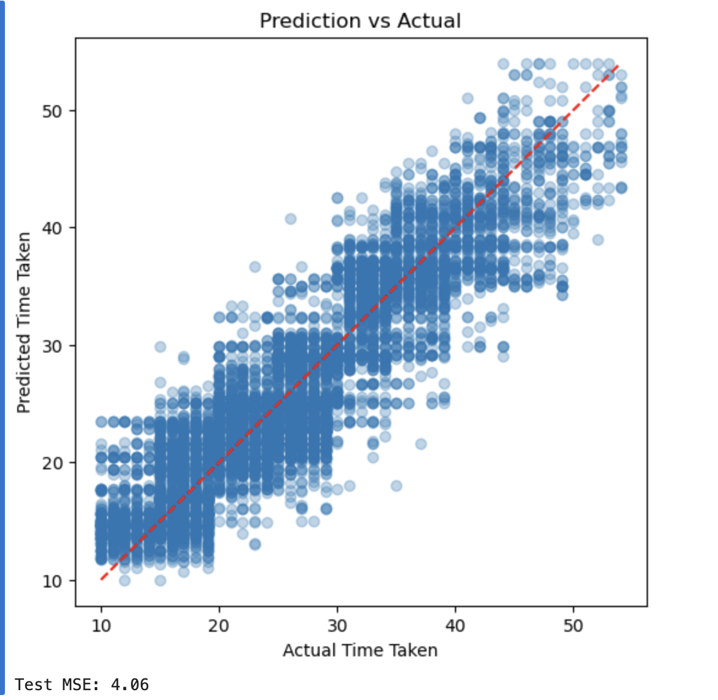
DecisionTree : Predicted vs Actual

Slide 18

SVR + MLP Stacked Ensemble Regression

Slide 19
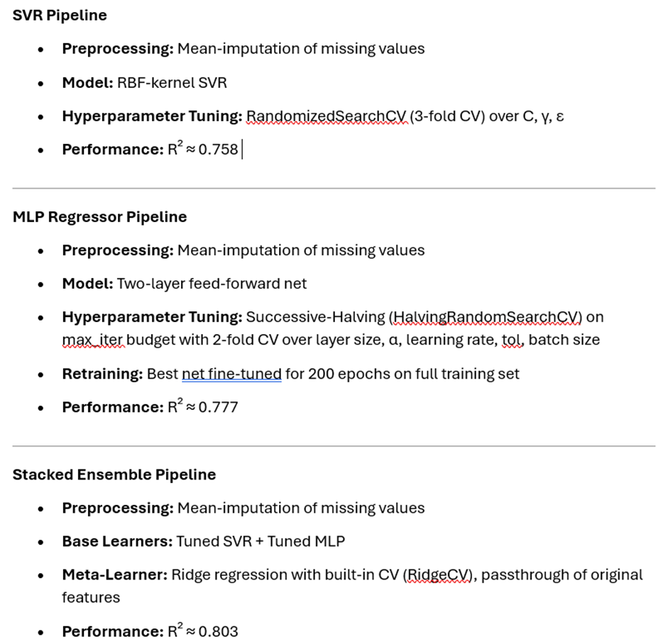

SVR + MLP Stacked Ensemble Regression
Notes:
MLP Regressor (Multi-Layer Perceptron for Regression)
A feed-forward neural network that learns a nonlinear mapping f:X→yf: \mathbf X \to yf:X→y
Trained via backpropagation to minimize a regression loss Why MLP Regressor?
Excels at learning complex, nonlinear relationships and feature interactions in high‑dimensional data
Flexible architecture (multiple layers, activations, regularization) that can be tuned to our problem
Why SVR (RBF Kernel)?
Kernel trick captures intricate patterns without overfitting small‑to‑medium datasets
Strong regularization via the C and ε parameters for robust generalization
Why Stacking?
Combines complementary strengths: SVR’s kernel‑based smoothness with MLP’s flexible nonlinear mapping
Meta‑learner (RidgeCV) automatically balances their predictions and original features, yielding a higher R² than either model alone
Empirically delivered the best performance (R² ≈ 0.803) by reducing each model’s individual biases and variance

Slide 20
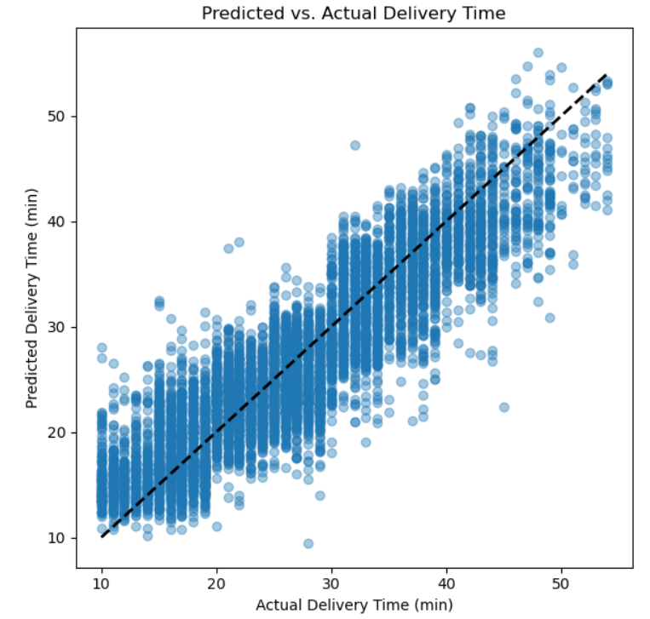
Stacked Pipeline Performance: Before and After
MLPRegressor Model
Metric | Value
MAE | 4.38 minutes
RMSE | 3.4 minutes
R² | 0.7771
Adjusted R² Score | 0.7766
MLPRegressor + SVR Pipeline
Metric | Value
MAE | 4.02 minutes
RMSE | 3.26 minutes
R² | 0.8027
Adjusted R² Score | 0.8021
On average, the combined model delivery‑time predictions are within about ±14 % of the true value(MAPE). The stacked SVR + MLP ensemble makes accurate, unbiased predictions across most of the delivery‑time range.

Slide 21

Random Forest

Slide 22

RandomForestRegressor
Parameter | Value
objective | RandomForest Regressor
Random_state | 42
n_estimators | 100
Metric | Value
MAE | 3.08 minutes
RMSE | 3.85 minutes
R² | 0.830
Adjusted R² | 0.8304

Slide 23
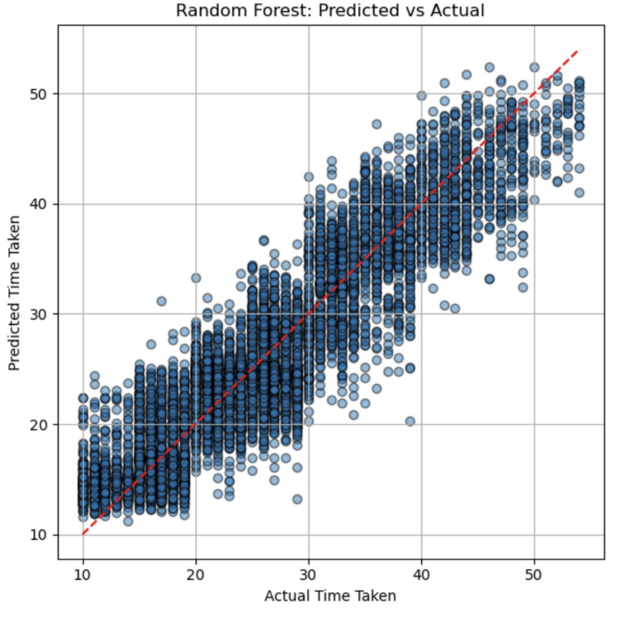
Random Forest : Predicted VS Actual
.
Strong Predictive Alignment: The predicted values closely follow the actual time taken, forming a dense cluster around the ideal red line (y=x), indicating high model accuracy.
Edge Case Deviations: The model shows some over- and under-predictions, particularly at lower and higher ends of the time range

Slide 24

XG Boost

Slide 25
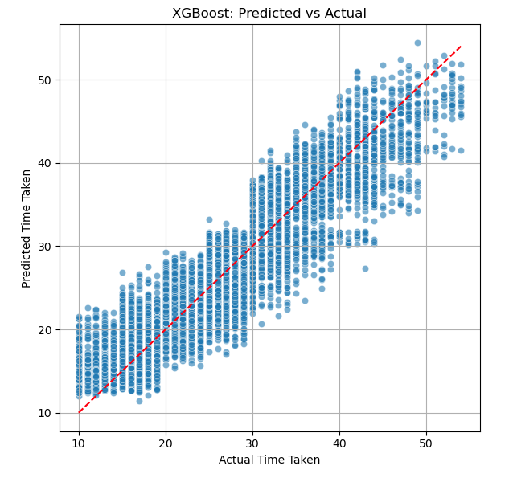
XGBoost
Parameter | Value
objective | reg:squarederror
max_depth | 6
learning_rate | 0.1
eval_metric | rmse
n_estimators | 100
Metric | Value
MAE | 3.10 minutes
RMSE | 3.84 minutes
R² | 0.8317
Adjusted R² | 0.8303
On average, the XGBoost model’s delivery-time predictions are within approximately ±13% of the true values (MAPE)
The model produces accurate, consistent predictions across the full delivery-time range, with minimal bias

Slide 26
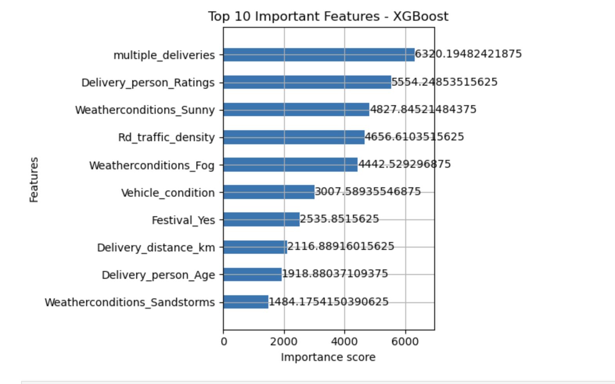
Top 10 Influential Features – XGBoost
Multiple deliveries, delivery person rating, and sunny weather had the highest impact on delivery time.

Slide 27
Model Performance Comparison
Model | MAE (Min) | RMSE (Min) | R² | Adjusted R²
KNN | 5.05 | 3.96 | 0.7097 | 0.7090
Decision Tree | 3.22 | 4.06 | 0.8125 | 0.8120
Stacked SVR + MLP | 4.02 | 3.26 | 0.8027 | 0.8021
Random Forest | 3.08 | 3.85 | 0.830 | 0.8304
XGBoost | 3.10 | 3.84 | 0.8317 | 0.8303
Best Overall Model : XGBoost
It has the highest R² Score (0.8317), meaning it explains the most variance in delivery time.
Its MAE and RMSE are very close to Random Forest — only slightly higher, but it generalizes slightly better based on R².
Adjusted R² is also nearly equal to Random Forest (0.8303 vs 0.8304), showing strong consistency even after adjusting for feature count.

Slide 28
Generated Insights
Multiple deliveries significantly increase delivery time
Higher delivery person ratings lead to faster deliveries
Sunny weather is associated with quicker delivery; fog/sandstorms cause delays
Traffic density is a strong factor — higher traffic = slower delivery
Deliveries during festivals tend to take longer due to roadblocks and demand spikes
Vehicle condition has a measurable effect on delivery speed
Longer distances and longer prep times naturally increase total delivery time

Slide 29
Recommendations
Avoid assigning too many orders to a single delivery partner
Prefer experienced or highly-rated delivery partners during peak hours
Use traffic and weather forecasts to adjust delivery time estimates
During festivals, increase delivery buffer time or resources
Consider vehicle type and condition when assigning long-distance deliveries

